Slide 1
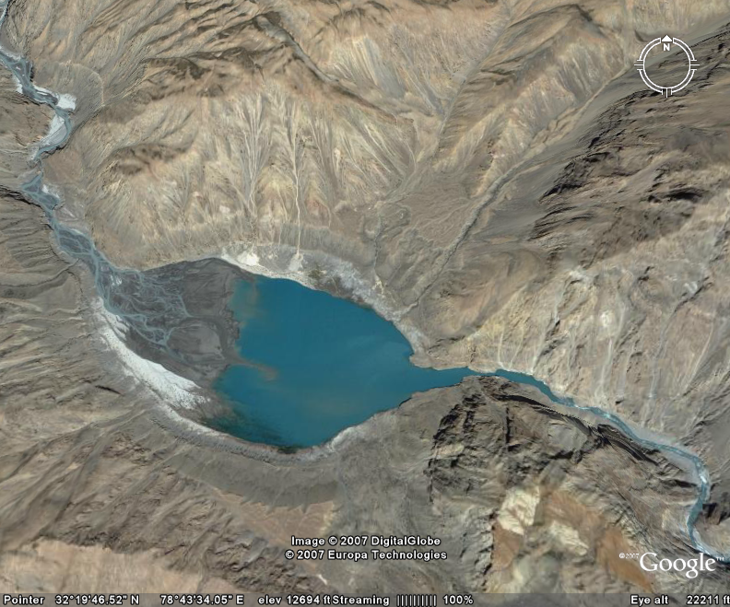
OPTIMISATION OF GEOLOGICAL INVESTIGATIONS FOR FORMULATION OF DPR FOR WATER RESOURCES PROJECTS
By
Dr. Y. P. Sharda

Slide 2
Geological Investigations/ Explorations
Every Civil Engineering Structure for its safe and cost effective execution needs to be designed optimally.
Safe and cost effective designing requires that nature of ground on which the structure is to be built is known to the extent possible.
This can be determined through optimum geological & geotechnical investigations.

Slide 3
Geological Investigations/ Explorations
Geological Investigations/ Explorations cover both surface as well as subsurface investigations.
The type and extent of investigations/ explorations should commensurate with the size and type of the project.
The explorations should be rationally planned with the aim to collect maximum possible data/ information

Slide 4
Geological Investigations/ Explorations
Stages of Geological Investigations:
Conceptual stage
Reconnaissance stage
Preliminary Investigations
Detailed Exploration
Pre-construction stage
Construction stage
Post construction stage

Slide 5
Geological Investigations/ Explorations
Ministry of Power, Government of India through O.M. No. 16/31/2000-DO (NHPC) dated 8th June 2001 proposed three stage development of hydroelectric projects.

Slide 6
Stage-I includes survey, investigations and preparation of pre- feasibility report for hydroelectric projects.
The Stage-II development involves detailed investigations preparation of DPR, pre-construction works, obtaining necessary clearances, development of infrastructural facilities and land acquisition etc.
Stage-III, Construction Stage would require the approval of PIB/ CCEA for investment decision in respect of construction of the project.

Slide 7

Stage- II Geological Investigations
The objective of investigations at this stage is to prepare the DPR.
For all infrastructural projects, whether water resources or infrastructural, preparation of a DPR is a statutory requirement so that the techno-economic justification of the project is established.

Slide 8
In the past, a vast majority of the projects could only be completed with enormous cost and time overruns rendering the techno-economic evaluations done on the basis of original DPRs irrelevant.
Because of the past experience of huge cost and time overruns in the field of water resources development and increasing the importance of cost of financing, the concept of ‘Bankable DPR’ was evolved.

Slide 9
A bankable DPR should give enough confidence to the prospective financing agency that the major components of the project have been well designed using reliable and adequately detailed field data so that scope and nature of work would not undergo major changes during construction stage.

Slide 10
The constraints and uncertainties, though kept low, are well understood and suitable provisions made in design so that these are not met as surprises.
The main requirement of a DPR being bankable is the assurance of the project being constructed within the estimated cost and the time schedule.

Slide 11

This can be achieved by optimizing geological investigations in order to obtain maximum information required keeping in view the costs and time.
Efforts should be made to maintain the quality of investigations to facilitate the realistic interpretations.

Slide 12

Stage-II
Usually by the time this stage is reached, rough designs of project components have been prepared.
The detailed exploratory program is formulated and executed at this stage.

Slide 13
Hydroelectric Projects
  Power House (Surface / Underground).
    Switch Yard
Dam
Shaft
Adit
Approach
Surge shaft
Desilting Chamber
Fore bay
H R T
Anchor Blocks
Penstock
Adit
(Adit can be used as spillway in some cases)
Power House
TRT/TRC

Slide 14

The basic task at this stage is:
to determine in details the characteristics of the overburden and the bed rock in the river section and on the abutments in the project area
b) to investigate thoroughly the potential leakage zones in dam foundations and in reservoir.
For this, if required groundwater observation wells can be established.

Slide 15

During this stage, serious consideration is given to:
Impact of lithology, structural elements and topography on the location of the proposed appurtenants including reservoir.
Availability of suitable construction material as it may influence the type of dam that can be constructed at a site.
The suitability of site with regard to planned structure and suggested modifications.

Slide 16

Detailed geological information during this stage of the investigations is obtained from:
    Investigations
    Detailed surface geological mapping
    Exploratory Drilling
    Exploratory pitting/ trenching and drifting.
    Geophysical explorations
    Seismological and seismo-tectonic studies

Slide 17

In case of water retaining structure or other appurtenants, detailed geological mapping of the site covering adequate area on all sides should be carried out on suitable scale, preferably on 1:500 or 1:1000 scales, depending on the size of the structure.

Slide 18

Detailed Surface Mapping
The subsurface exploration program should be planned depending upon the type of appurtenant, results of geological mapping and other site specific requirements.
Efforts should be made to optimise the explorations so that maximum information is obtained from minimum explorations.

Slide 19
The accuracy of predicting the characteristics and behavior of strata depends on the quality of drilling and other subsurface explorations as many projects have suffered on this account in the past.
Therefore high quality of drilling and other types of investigations should be insisted upon.

Slide 20
The riverbed and abutments along the dam axis should be explored through adequate number of drill holes.
The drill holes may extend at least 10-15m into foundation grade rock in general or atleast 30m below foundation grade in case of structures to be founded on permeable foundation.

Slide 21
One or two drill holes may be extended to depth down to which foundation treatments are likely to extend.
Adequate no. of drill holes should be drilled at the toe of the dam and in the energy dissipation structure.
If the conditions in the riverbed can not be established by vertical drilling, inclined drill holes may drilled from banks.

Slide 22
Permeability tests may be conducted in all the drill holes
The goutability of the foundation should also be established at this stage through trial or test grouting.
The geotechnical properties of the foundation medium may be determined by conducting laboratory tests on samples and in-situ tests at specific locations

Slide 23
Geophysical Explorations
Since drilling and other subsurface explorations are costly and time consuming operations, these may be supplemented witn geophysics explorations wherever possible.
The gap areas can be explored through geophysical techniques as these yield quick results.

Slide 24

These can be employed to determine the depth to bedrock in overburden covered areas and assess the nature & quality of the strata in combination with drilling in case of
dams,
surface powerhouses
in selected areas along tunnel routes.
along penstock/ pressure shaft alignments
ground water investigations along tunnels and
Delineation of cavities, caverns, channels in case of karst

Slide 25


Exploratory pitting and trenching
The abutments and riverbed in some cases can be explored through exploratory pits and trenches where overburden is not expected to be thick.
These are common tools in case of investigation of borrow areas.
These can be utilized to collect samples for testing and conducting field tests.

Slide 26

Exploratory Drifting
Both the abutments of the dam should be explored through exploratory drifts.
For a dam of height up to 50m, one drift on either abutment with cross cuts have been recommended.
For a dam of height between 50m and 100m, two drifts on either abutment with cross cuts have been recommended.
For a dam of height > 100m, three or more drifts on either abutment with cross cuts have been recommended.

Slide 27
        All the exploratory drifts should be continuously logged as these progress and logs with recommendations should be supplied to designers so that, if required, designs are updated.
        These are also utilized to conduct in-situ rock/soil mechanics tests to characterize the behavior of rock mass.

Slide 28
The goutability of the foundation through trial or test grouting should also be established at this stage.
The geotechnical properties of the foundation medium should be determined by conducting laboratory tests on samples and in-situ tests at specific locations.

Slide 29

The desanding arrangement may either be surface one or located underground in either abutment
In case of structure located on the surface, the site may be explored through detailed surface geological mapping, geophysical surveys followed by confirmatory exploratory drilling incase it is covered by overburden.
The drill holes may be drilled either 5-10m in to bed rock or 30m depth, whichever is less.

Slide 30
In case of underground desanding chamber, the site may be investigated through detailed geological mapping.
Surface geological mapping may be followed by exploratory drilling if ground cover over the structure is moderate.
The alignment of one of the chambers may be explored through an exploratory drift in case the size of chambers is large and ground cover is is high.

Slide 31

In case of tunnels, whether approach tunnel to desanding chambers, HRT, tailrace, or diversion tunnel, the requirements are to know:
The nature and quality of strata likely to be encountered and types of the supports required during construction.
Adequacy of rock cover over the structure.
Location of weak zones and
Whether water is likely to encountered, if so in which portions and in what quantities.

Slide 32
Location of portals of tunnel as well as construction adits be specified and treatments, if required may be detailed.
If required the sites of the portals may be investigated through geophysical tools and drilling.

Slide 33

The geological investigations required to be carried out along the alignment of the tunnel include:
Surface geological mapping of the alignment on suitable scale covering adequate width on both sides.
Geophysical surveys in certain reaches to assess the adequacy of the rock cover and presence of ground water.
Drilling in selected low cover reaches to assess the adequacy of rock covers and rock mass quality.

Slide 34
Many projects in our country like Dul- Hasti HEP, Parvati Stage-II and Lata -Tapovan HEP have suffered huge economic losses and time over runs due to abrupt encountering of large quantities of subsurface water under very high hydraulic head.
The presence of such large quantities of water could not be predicted with the investigations carriedout till then at these projects.

Slide 35

As per prevalent practice in the country, hydrological parameters are qualitatively estimated from the normalised approach using Lugeon test.
It is now recognised that this kind of approach is not quite appropriate because:
The Lugeon type of test is an injection test and does not correspond to the physical process of water drainage, which is a natural production of water from the formation.

Slide 36
DST
The viscosity of the injected fluid (a mixture of water and mud) may not be well defined and does not allow an accurate calculation of the hydrogeological parameters of the formation.
The injection process for the Lugeon test may modify the geotechnical conditions of the formation, thus modifying its hydro-geological parameters.
Moreover, these tests do not allow deter-mining the formation pressure.

Slide 37
DST
For the above reasons, in recent years, more and more tunnel designers had been looking for an alternative to Lugeon tests.
New testing tool has been designed to investigate the formation from vertical or inclined boreholes and also systems based on the use of testing tools in horizontal boreholes, drilled along the tunnel route.
This is known as Drill Stem Test (DST)

Slide 38
Drill stem testing is an oil and gas exploration procedure to isolate, stimulate and flow a down hole formation to determine the fluids present and the rate at which they can be produced.
The main objective of a DST is to evaluate the commercial viability of a zone’s economic potential by identifying productive capacity, pressure, permeability and extent of an oil or gas reservoir.
These tests can be performed in both open and cased hole environments and provide exploration teams with valuable information about the nature of the reservoir.

Slide 39
DST
The horizontal holes can be drilled from the surface from exploratory boreholes before tunnel construction using the directional drilling method, or
Can be drilled from the excavation face in a tunnel under construction.
DST is used to estimate the quantity of water and pressure at which water would ingress into the tunnel. This test is being performed for long time in oil industry to know about the producing potential of a formation.

Slide 40
Drainage calculation as a planning instrument in tunnel construction for hydro-geological study, is a recent approach.
It is observed that combined with other informations including geological, geochemical and geotechnical data, initial rate calculation allows identifying the critical zones during tunnel construction.
Thus, appropriate measures can be planned in advance, resulting in a reduction of stand-by time during excavation.

Slide 41
The two methods of testing are:
the ‘Bottom hole method’ - isolation of a zone at the bottom of a borehole and
the ‘Straddle method’ - packers are placed above and below a zone of interest in a borehole.

Slide 42
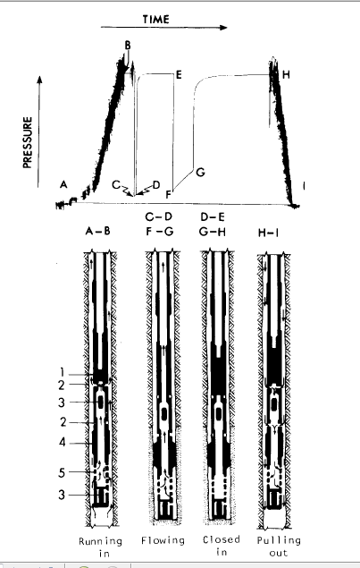
Drill-stem-test
phases and pressure record.
1-Tester valve.
2-By-pass port.
3-Pressure recorder.
4-Packer.
5-Perforated anchor]

Slide 43
Double packer test system.

Slide 44

Drill stem testing involves deploying a series of tools known as a test bottomhole assembly (BHA).
A basic drill stem test BHA consists of a packer or packers, which act as an expanding plug to be used to isolate sections of the well for the testing process, valves that may be opened or closed from the surface during the test, and recorders used to document pressure during the test.

Slide 45
In addition to packers, a downhole valve is used to open and close the formation to measure reservoir characteristics such as pressure and temperature which are charted on downhole recorders within the BHA

Slide 46
Pump-Down Packer System:
The use of pumped packer systems in horizontal exploratory boreholes and the corresponding testing program together with test interpretation has been developed for a deep tunnel project.
The tool developed for this project is called ‘PDPS’ is shown in Figure. After coring a new hole, the string is partially retrieved from the end of the borehole (in the order of 50 m to 100 m).

Slide 47
Testing operations can then be performed on the isolated interval below the external packer and are recorded in the tool by means of two pressure recorders.

Slide 48
The system is then pumped through the coring string. Once it has arrived at the end, the tool lands on a no-go-shoulder at the coring bit and latches in the outer core barrel.
In such a configuration, a first ‘external’ packer passes through the coring bit into the open-hole, and a second ‘internal’ packer remains inside the coring string. Increasing the pump pressure at the surface causes the two packers to inflate and eventually enables the passage of the interval below the external packer to the pipe inside above the internal packer.

Slide 49
Lötschberg Base Tunnel: The 35 km long Alpine tunnel crosses karstified and fractured limestone under an overburden of 1000 m.
During the construction of the tunnel horizontal holes were bored along geological features to localize and characterize ground water zones.
Borehole lengths were up to 1300 m and water pressures were expected to be up to 75 bars. Pump-Down Packer System (PDPS) was used in horizontal boreholes drilled ahead of the tunnel excavation face.

Slide 51
Surge shaft
The surge shaft may either be open to sky or underground depending upon the topography at the site.
The area around the structure may be covered by detailed geological mapping in order to assess the suitability of the site for locating the structure.
The site of open to sky structure may be explored through a drill hole located within the periphery of the structure and going down to about 5m below the bottom of the structure.

Slide 52
In case of an underground structure, the site, in addition to detailed surface geological mapping, if possible, may be explored by drill hole extending down to 5m below bottom level.
Other wise it may be explored through an exploratory drift reaching the bottom elevation of the structure.
Further a drill hole may be drilled upwards reaching the top elevation of the shaft.
The drift can later be used as construction adit.

Slide 53
Penstock or Pressure shaft
Detailed geological mapping may be utilised to identify the quality of excavation media & stability of the slope.
In case of penstock, the locations of anchor blocks may be explored either through exploratory pits or drill holes, depending upon the thickness of over-burden with a view to assess the foundation media for these.
In case of pressure shaft, in addition to assessing the rock mass quality, portals of construction adit may be identified and mapped and if required, treatments needed may be defined .

Slide 54
Powerhouse
In case of powerhouse, if it is surface structure, the area should be adequately explored through drill holes to assess the thickness of overburden, the characteristics of strata present at foundation grade and if required treatment for foundations be formulated.
Its safety from floods and stability of back slopes should be assessed and treatment measures required to stabilize them evolved.

Slide 55
In case of Underground Powerhouse,
detailed surface geological mapping should be carried out on appropriates scale.
Geological map can be utilised to finalise the location of the powerhouse cavern and its orientation depending upon the structural elements.
Alignments of other anciliaries like MAT, Cable tunnel, ventilation tunnel and switch yard etc may be finalised depending up on the availability of suitable portal locations.

Slide 56
The site for power house cavern may also be explored through three to five drill holes depending upon the size of structure if the ground cover the structure is moderate.
However, the proposed underground cavern may be explored fully all along its length by an exploratory drift with cross cuts for assessing the quality of rock maass so thatsupport system is designed.

Slide 57

        All the exploratory drifts should be continuously logged as these progress and logs with recommendations should be supplied to designers so that, if required, designs are updated.
        These are also utilized to conduct in-situ rock mechanics tests to characterize the behavior of mass.

Slide 58
Seismological and Seismotectonic Studies:
Should include collection of all seismo-tectonic data through literature survey and location of major thrusts, faults and lineaments around the project. Their position with respect to the project defined.
The data about the seismic history should also be collected from available records and concerned organizations

Slide 59
Construction Material
S
Availability of required quantities of all types of construction materials and their suitability should be established through proper investigations and testing and borrow area identified.

Slide 60
The results of the explorations carried up to this stage should be compiled in the form of report to be incorporated in the DPR.
All relevant data with interpretations and recommendations should be presented as clear as possible.

Slide 61
Limitations and further explorations required should be spelt out in clear terms because the taking of project to next stage i.e. construction stage & completing it within financial and time schedules depends on the quality of DPR.

Slide 62
Thank You

